Slide 1
Giacomo Cappon
Persistence – Part 1
Notes:
This lesson will be easier and lighter with respect to the others because I want to you to fix in your mind the concepts we learned so far.

Slide 2
Outline
Persist key-value data
SharedPreferences
Counter app with persistence
Exercise
Homework
Resources

Slide 3
Outline
Persist key-value data
SharedPreferences
Counter app with persistence
Exercise
Homework
Resources

Slide 4
Outline
Persist key-value data
SharedPreferences
Counter app with persistence
Exercise
Homework
Resources

Slide 5
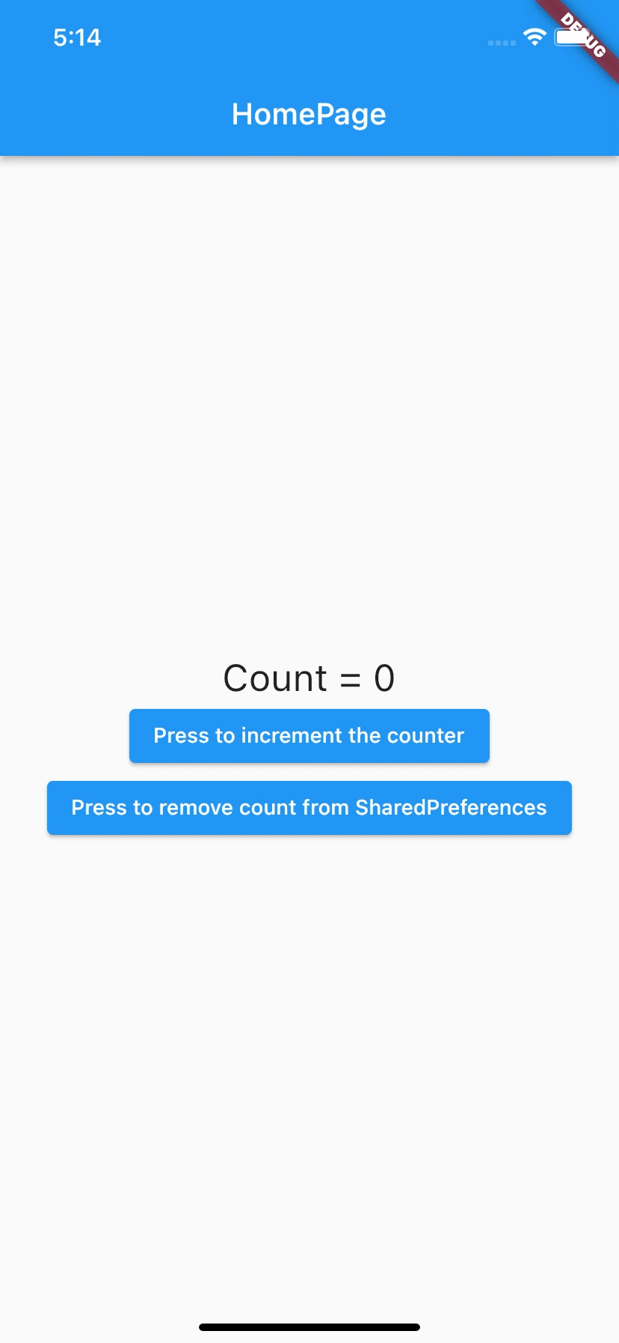
Counter app with memory
Exercise 10.01 (easy-medium)
Start from the code of Exercise 06.02
Right now, every time you restart the app, the LoginPage is showed to user
Use the SharedPreferences package to change this behaviour and let the app “remember” the last user session. As such:
If a user opens the app for the first time, the LoginPage route is showed;
If the user logs in, the HomePage is showed;
If a user restarts the app and he/she did not log out in the last session, the HomePage is showed;
If a user restarts the app and he/she log out in the last session, the LoginPage is showed.

Slide 6
Outline
Persist key-value data
SharedPreferences
Counter app with persistence
Exercise
Homework
Resources

Slide 7
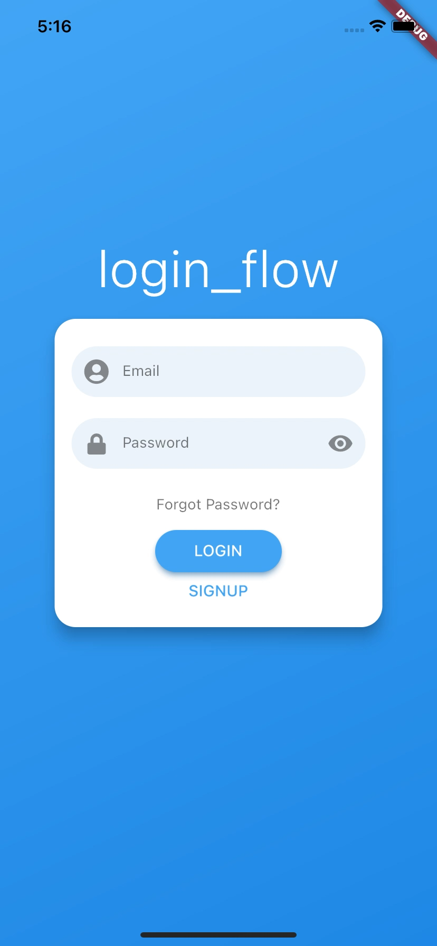
Exercise
Exercise 10.01 (easy-medium)
Start from the code of Exercise 06.02
Right now, every time you restart the app, the LoginPage is showed to user
Use the SharedPreferences package to change this behaviour and let the app “remember” the last user session. As such:
If a user opens the app for the first time, the LoginPage route is showed;
If the user logs in, the HomePage is showed;
If a user restarts the app and he/she did not log out in the last session, the HomePage is showed;
If a user restarts the app and he/she log out in the last session, the LoginPage is showed.

Slide 8
Outline
Persist key-value data
SharedPreferences
Counter app with persistence
Exercise
Homework
Resources

Slide 9
Homework
Get familiar with SharedPreferences
Take look to a safer alternative: flutter_secure_storage
https://pub.dev/packages/flutter_secure_storage

Slide 10
Outline
Persist key-value data
SharedPreferences
Counter app with persistence
Exercise
Homework
Resources

Slide 11
Resources
SharedPreferences package
https://pub.dev/packages/shared_preferences
Flutter community cookbook on SharedPreferences
https://docs.flutter.dev/cookbook/persistence/key-value

